Slide 1
Chapter Quiz
Coding and Programming

Slide 2
Quiz
Chapter 4
For Student
ⓒ2023 SAMSUNG. All rights reserved.
Samsung Electronics Corporate Citizenship Office holds the copyright of this document.
This document is a literary property protected by copyright law so reprint and reproduction without permission are prohibited.
To use this document other than the curriculum of Samsung innovation Campus, you must receive written consent from copyright holder.

Slide 3
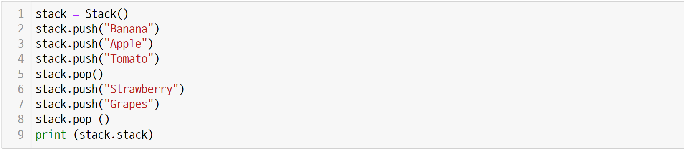
UNIT 22
Stack
Q. 22-01
The following is the implantation of stack. What will be the output of the code below?

Slide 4
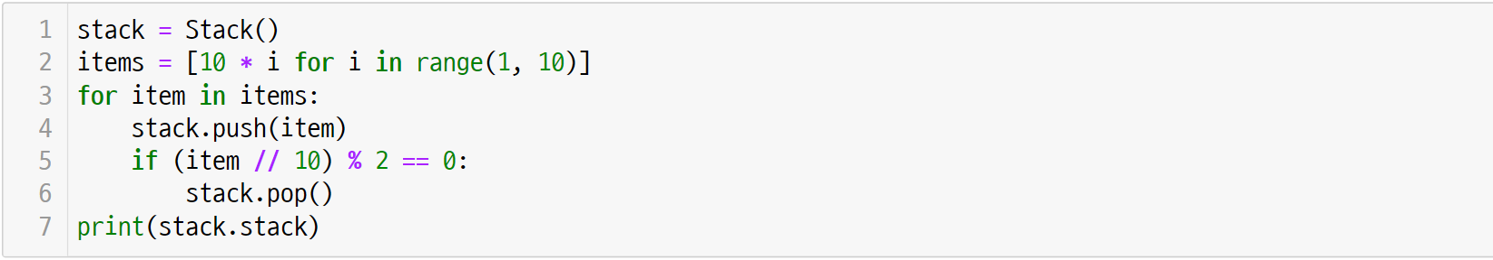
UNIT 22
Stack
Q. 22-02
The following is the implantation of stack. What will be the output of the code below?

Slide 5
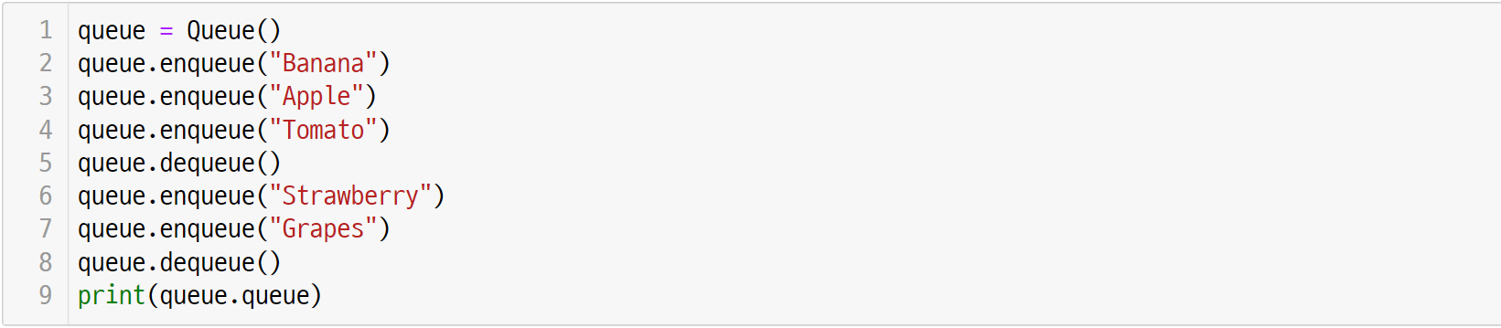
UNIT 23
Queue
Q. 23-01
This is the implementation of queue. What will be the output of the code below?

Slide 6
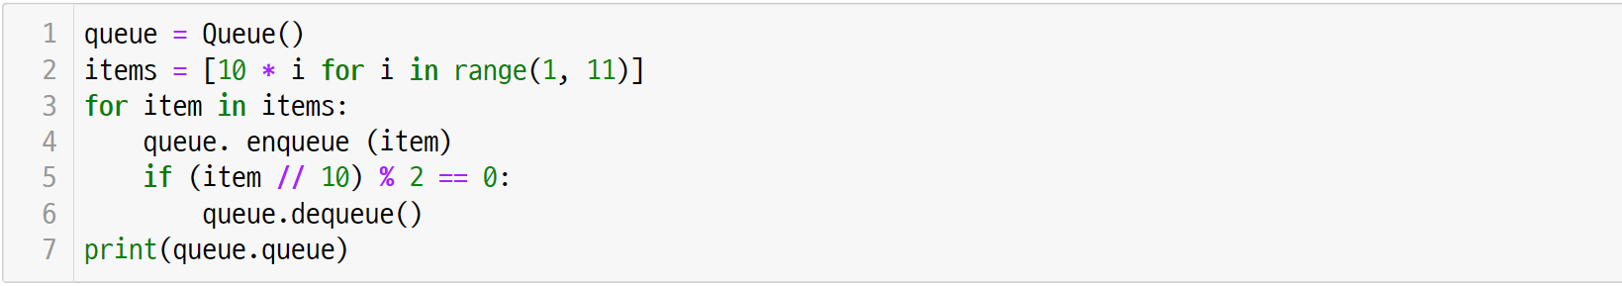
UNIT 23
Queue
Q. 23-02
This is the implementation of queue. What will be the output of the code below?

Slide 7
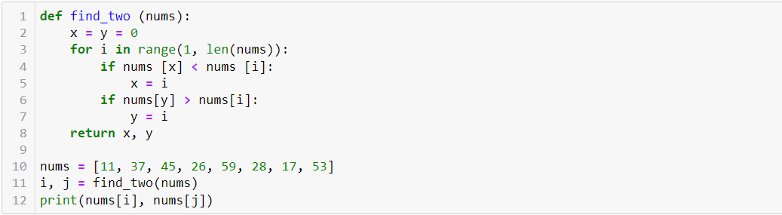
UNIT 24
Sequential Search
Q. 24-01
What does the algorithm of the find_two() function below do? Analyze the code and write the execution result.

Slide 8
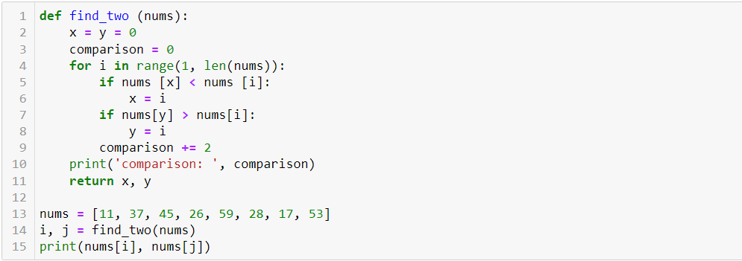
UNIT 24
Sequential Search
Q. 24-02
How many comparisons should the find_two() function perform?

Slide 9
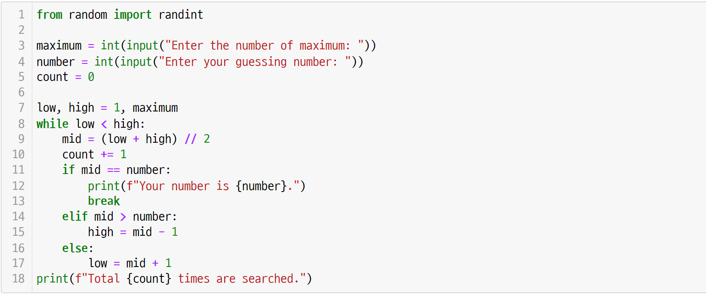
UNIT 25
Binary Search
Q. 25-01
The following is the code for the number matching game. If the maximum is 100 and the number is 51,
what is the output of count?

Slide 10
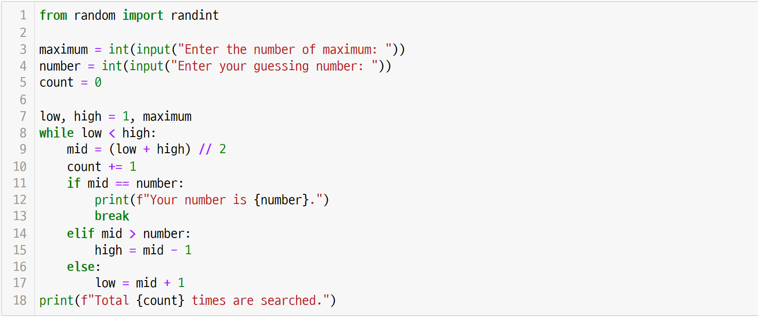
UNIT 25
Binary Search
Q. 25-02
In the code for the number matching game, if the maximum is 100 and the number is 25, what is the output of count?

Slide 11
UNIT 26
Hash Table
Q. 26-01
Using the hash function of the HashTable class, calculate the key and hash key of “Alice in Wonderland” as follows. (The key value is 1763.)

Slide 12
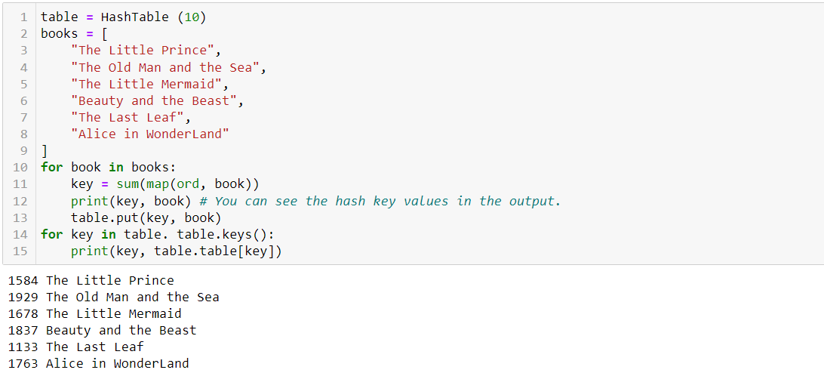
UNIT 26
Hash Table
Q. 26-02
If a new bookshelf has 10 compartments, use the following code to find out which book is in each compartment.
Refer to the hash key values in the output below.

